Slide 1

Marianne M. Jennings
Business
Its Legal, Ethical, and Global Environment
10th Ed.
Chapter 4 Managing Disputes: ADR and Litigation Strategies

Slide 2
Types of ADR
Arbitration—Oldest Form of ADR
Parties submit grievances and evidence to a third party expert in an informal setting
American Arbitration Association provides many arbitrators and rules

Slide 3
Types of ADR
Arbitration Advantages
Less formality
Moves faster than a trial
Handled privately
Expert handles the cases

Slide 4
Types of ADR
Arbitration Disadvantages
Arbitrator may not have legal training and may not understand the significance of legal points
Rules of evidence do not apply
Expense and complexity has increased

Slide 5
Federal Arbitration Act
Passed to stop judicial interference with arbitration
Courts now rarely interfere with arbitration clauses in consumer contracts
Courts now rarely interfere with arbitration decisions

Slide 6
Types of ADR
Case 4.1 College Park Pentecostal Holiness Church v. General Steel Corp. (2012)
What was the basis for setting aside the arbitration clause?
How binding is arbitration?
Could the decision have been affected by the fact that there was a church involved?

Slide 7
Types of ADR
Arbitration Procedures
Parties agree to submit to arbitration
American Arbitration Association (AAA) can handle the proceedings for a fee
Demand for arbitration is filed
Arbitrator is selected

Slide 8
Types of ADR
Mediation
Parties use a go-between to negotiate and communicate
Used in international transactions
Mediator can offer suggestions for resolution
Not binding
MedArb
Recent creation in which arbitrator first attempt to mediate settlement
If unsuccessfully the case goes to arbitration

Slide 9
Types of ADR
Minitrial
Small-scale trial where parties present case to a judge with experience in the field or to a neutral advisor
Advisor or judge makes decision
Can motivate parties to resolve differences even if the results are not binding

Slide 10
Types of ADR
Rent-a-Judge
Trial held in commercial as opposed to a public court
Pay fees for courtroom and judge
Example: “The People’s Court” TV show
Summary Jury Trials
Gives parties an idea about jury’s perceptions
Used after discovery is complete

Slide 11
Types of ADR
Early Neutral Evaluation
Consultant or volunteer gives parties an assessment of the position
Generally used prior to discovery
Saves expenses if parties settle following the evaluation
Peer Review
Review of Management’s action against employee by a group of peer – employees
Reduces litigation cost

Slide 12
International ADR
International Chamber of Commerce
A private organization that handles 250 arbitration cases each year
Has used arbitration since 1922

Slide 13
International ADR
Centre for Settlement of Investment Disputes (ICSID)
An international arbitral for investors
Investment contracts can provide for arbitration by ICSID
Parties Free to Choose Which Courts Will Hear Their Disputes
Party autonomy
U.S. courts are a popular choice

Slide 14
Litigation vs. ADR
Technical discovery rules | Open lines of communication
Judicial constraints of precedent | Parties can agree to virtually anything
Remedies limited | Creative remedies
Docket backlog | Parties set time line
Public proceeding | Private
Control by lawyers | Control by parties

Slide 15
Litigation vs. ADR
Expensive | Less expensive (some changes here)
Strict procedures and timing | Flexible
Judge and juries unknown | Parties select
Judicial enforcement | Enforcement by good faith

Slide 16
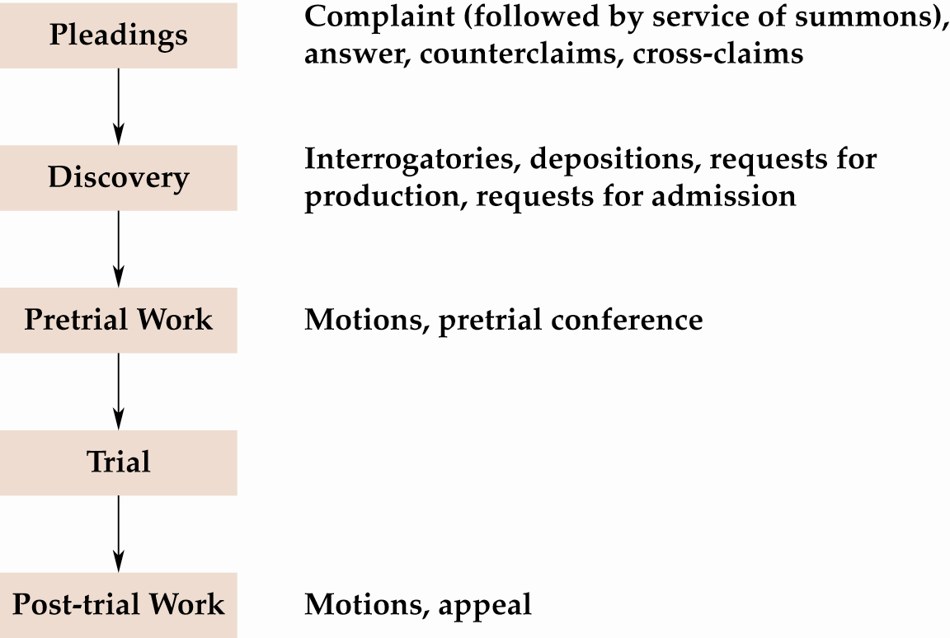
The Trial Process

Slide 17
When You Are in Litigation…
People Begin Civil Lawsuits
System does not do it for them
Based on a claim of right
Lawsuits are efforts of individuals to enforce their rights

Slide 18
When You Are in Litigation…
Step 1—Filing a Complaint or Petition
Complaint is general statement of claim
Must describe actions that led to claim of violation
Must establish jurisdiction and venue of court in which it is filed
Class actions are often filed against businesses

Slide 19
When You Are in Litigation…
Step 2—Service of Process
Complaint or petition and summons served on defendant
Summons explains to defendant his/her rights
Where to defend
How long to defend
The effect of not defending the suit
Delivered by an officer of the court or by licensed private process servers
In exceptional circumstances, service is accomplished by publication

Slide 20
When You Are in Litigation…
Step 3—The Answer
Content of answer
Defendant can admit allegations in complaint are true
Defendant can deny allegations in complaint
Defendant can counterclaim—effect is the defendant is also suing plaintiff for damages

Slide 21
When You Are in Litigation…
Step 3—The Answer
Failure to file an answer within the statutory time period is a default
Time limits for filing answers are typically twenty to thirty days
Like a forfeit in sports—plaintiff wins because the defendant fails to show up

Slide 22
When You Are in Litigation…
Step 4—Ending a Suit Through Motions
Motion for judgment on the pleadings
Even if everything the plaintiff said in the complaint were true, there is no cause for action
If court grants motion, the case is over at the trial court level (appeal is possible)

Slide 23
When You Are in Litigation…
Step 5—Pre Trial Motions
Motion for summary judgment
Appropriate in cases where there are no factual issues
Used to resolve questions of law when the parties agree on the facts

Slide 24
When You Are in Litigation…
Step 6—Discovery
Forms of discovery to supplement evidence released
Requests for admissions—request from one party to another for the admission of facts so that proof requested at trial is limited
Interrogatories—written questions submitted to opposition
Depositions—statements of parties or witnesses taken under oath in an informal setting
Request for mental or physical examination or for inspection

Slide 25
When You Are in Litigation…
Step 6—Discovery
Only relevant, non-privileged information is discoverable
NO:
Work product
Attorney/client privilege
Husband/wife privilege

Slide 26
When You Are in Litigation…
Case 4.2 Kroger Co. v. Walters (2012)
Discuss what type of evidence the video is.
What did the court allow the jury to assume?
What should managers learn from this case and what should they do when a customer is injured?

Slide 27
When You Are in Litigation…
Step 7—The Trial
Jury trial
Required in cases where damages over $20 are claimed
Absolute right to jury trial is only in criminal cases
Jurors selected from voting or drivers’ license lists
Voir dire
Used to narrow jurors for panel
Ask questions about their knowledge of the case, level of education, background, etc.

Slide 28
When You Are in Litigation…
Step 7—The Trial
Voir dire
Can be challenged for cause—incapable of making an impartial decision when they know parties, when they were involved with the case
Peremptory challenge—limited number of challenges used by attorneys to remove potential jurors with whom they are uncomfortable
However, may not be based on race or sex

Slide 29
When You Are in Litigation…
Step 7—The Trial
Plaintiff’s case
Presents witnesses—direct examination
Defendant can cross-examine plaintiffs’ witnesses
Opening Statement
Gives summary of the case and witnesses and how they fit together to prove necessary elements

Slide 30
When You Are in Litigation…
Step 7—The Trial
Post-plaintiff’s case motion—motion for a directed verdict
Plaintiff must prove all elements—called a prima facie case
Failure to prove all elements entitles defendant to a directed verdict
Made with jury excused

Slide 31
When You Are in Litigation…
Step 7—The Trial
Defendant’s case
Presents witnesses—direct examination
Plaintiff can cross-examine defendant’s witnesses
Types of evidence
Witnesses’ testimony
Documents
Photographs
Tangible items
Hearsay—can be admissible to establish facts other than the truth of the matter asserted

Slide 32
When You Are in Litigation…
Step 7—The Trial
Closing arguments
Each side summarizes case presented
Jury instructions
Judge explains law to jurors
Law is written in form for jurors to apply
Lawyers have input on instructions

Slide 33
When You Are in Litigation…
Step 7—The Trial
Jury deliberations
Some states do not require unanimous verdicts in civil cases - only a majority
If the jury can’t reach a verdict, a hung jury results in a mistrial

Slide 34
When You Are in Litigation…
Step 7—The Trial
Jury verdict
Decisions of the jury
One side can request to have the jury polled—occasionally any pressure exerted will come out then
Post-trial motions
Motion for a judgment NOV (non obstante veredicto)—motion for a judgment
Notwithstanding the verdict; effect is a trial court judge reversing the jury verdict—rarely done
Motion for a new trial—judge orders case retried

Slide 35
Steps in Civil Litigation

Slide 36
Steps in Civil Litigation (cont’d)

Slide 37
International Litigation
Which Laws Apply?
Foreign citizens may not come to U.S. to benefit from our traditionally liberal recovery rules and higher verdicts if there are adequate remedies in their own country

